Slide 1
Introduction to Databases
(Developing and Design of databases using SQL Server)
Trainer – Danilo Borozan
Co-Trainer – Ilija Mitev

Slide 2
WHAT IS A DATABASE?
A database is an organized collection of logically related data stored in a single repository.
Provides advantages over file system management approach.
Eliminates inconsistency, data anomalies, data dependency, and structural dependency problems.
Stores data structures, relationships, and access paths.
We can access this data through database management system.

Slide 3
EXAMPLE OF A TRADITIONAL DATABASE
Suppose we are building a system to store the information about:
Customers
Products
Orders

Slide 4
NO DATABASE MANAGEMENT SYSTEM SOLUTION
Can we implement a database application without a database management system (DBMS)? Sure we can! Start by storing the data in files:​
​
Customer.txt Product.txt Order.txt​
​
Now write C or Java programs to implement specific tasks:
Perform an order: “Customer A” orders “Product A”
Write a C program to do the following:
File
File
File

Slide 5
EXAMPLE OF WORKING WITH NO DBMS SOLUTION
Read ‘Customer.txt’
Read ‘Product.txt’
Write in ‘Orders.txt’ - “Customer A orders Product A”
Write in “Product.txt” - “Product A” has changed available quantity

Slide 6
PROBLEMS OF WORKING WITHOUT DBMS
Problems and crashes are hard to track and detect
The larger the files, the slower the operations
Difficulty with concurrency – Multiple users accessing the data at the same time
Data is very inconvenient to access

Slide 7
WHY DO WE NEED DBMS
Makes data management more efficient and effective
Concurrent access from multiple users/applications
Query language allows quick answers to ad hoc queries
Data security
Promotes integrated view of organization’s operations
Reduces the probability of inconsistent data
Locking mechanisms
Uniform administration procedures for data

Slide 8

TYPES OF DATABASES

Slide 9
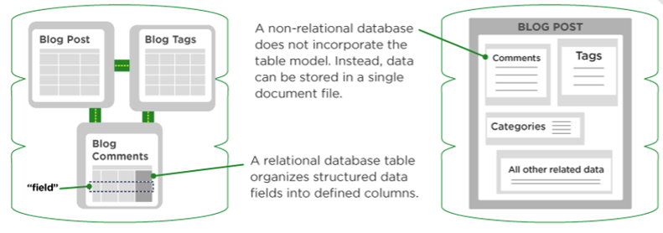
TWO MAIN TYPES
Relational databases (SQL)
Non-Relational databases (NoSQL)

Slide 10
DIFFERENCE BETWEEN SQL AND NOSQL
SQL​ | NoSQL​
RELATIONAL DATABASE MANAGEMENT SYSTEM (RDBMS)​ | Non-relational or distributed database system​
These databases have fixed or static or predefined schema​ | Databases have dynamic schema​
These databases are not suited for hierarchical data storage​ | These databases are best suited for hierarchical data storage.​
These databases are best suited for complex queries​ | These databases are not so good for complex queries​
Vertically Scalable​ | Horizontally scalable​

Slide 11
SUB-TYPES AND VENDORS
Relational database management system (RDBMS)
Structured (table based), SQL language used
Fixed and static data
Most popular vendors: SQL Server , Oracle, MySQL, PostgreSQL
Non-Relational databases (NoSQL DBMS)
Non structured, dynamic shema
Document based, key-value pairs, columnar and graph formats
Well suited for loosely defined data structures that may evolve over time
Most popular vendors: MongoDB, Cassandra, Hbase, CoachDB

Slide 12

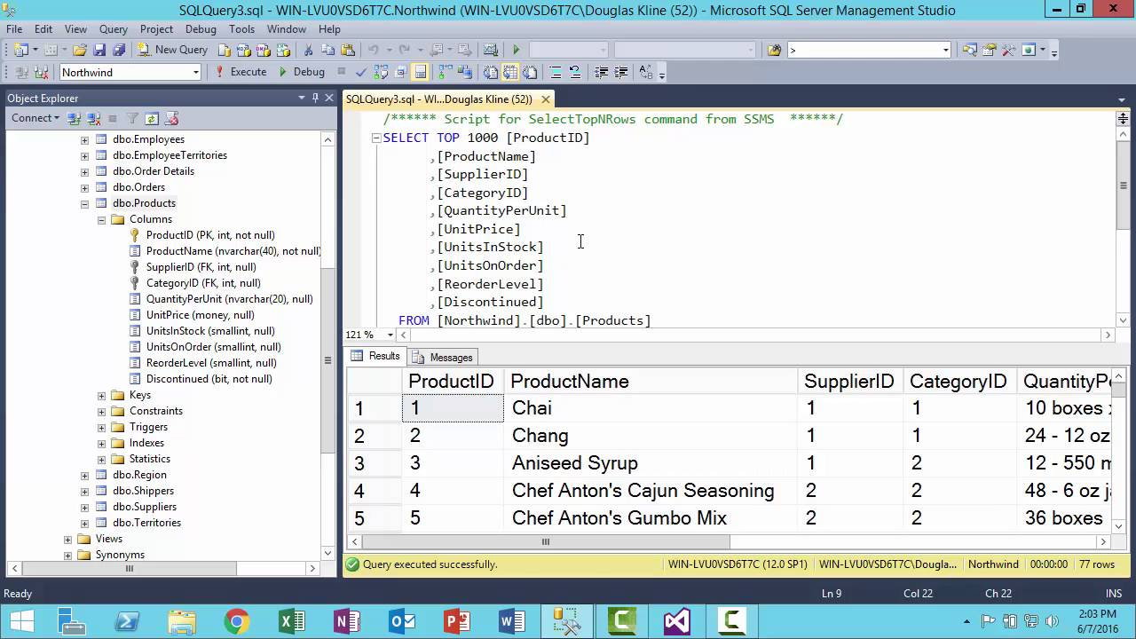
INTRODUCTION TO SSMS / SSMS UI

Slide 13
DATA DEFINITION LANGUAGE ( DDL )
DDL is a subset of the Transact-SQL language.
It deals with creating database objects like tables, constraints, and stored procedures.
The interface used to create these underlying DDL statements is the SSMS user interface.

Slide 14
KEY TERMINOLOGY (DDL)
USE: Changes the database context
ALTER: Changes an existing object.
CREATE: Creates a database object (table, view, or stored procedure)
DROP: Removes an object from the database.
TRUNCATE: Removes rows from a table and frees the space used by those rows.

Slide 15
DATA MANIPULATION LANGUAGE (DML)
Data Manipulation Language is the language element that allows you to use the core statements INSERT, UPDATE and DELETE to manipulate data in any tables.

Slide 16
KEY TERMINOLOGY (DML)
SELECT: Retrieves rows from the database and enables the selection of one or many rows or columns from one or many tables in SQL Server
INSERT: Adds one or more new rows to a table or a view in SQL Server
UPDATE: Changes existing data in one or more columns in a table or view.
DELETE: Removes rows from a table or view
*to better understand the difference between truncate and delete: truncate, after deleting the data, recreates an empty table (which is much faster than deleting rows one by one, particularly for large tables) whereas delete simply removes the rows

Slide 17
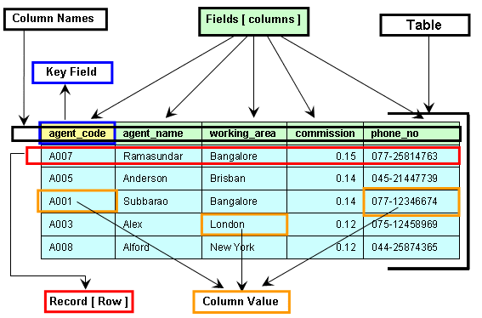
TABLE SYSTEM AND TERMINOLOGY

Slide 18
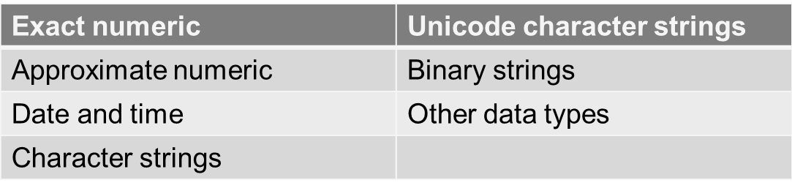
DATA TYPES
SQL data type is an attribute that specifies type of data the object can hold: integer data, character data, monetary data, date and time data, binary strings, and so on.

Slide 19
In SQL Server, each column, local variable, expression, and parameter have a related data type.
You have to decide what types of data will be stored inside each and every table column when creating a SQL table.
The data type is a label and a guideline for SQL to understand what type of data is expected inside of each column, and it also identifies how SQL will interact with the stored data.

Slide 20
LIST OF DATA TYPES (Numeric)
Data type​ | Range​ | Storage​
bigint​ | -2^63 (-9,223,372,036,854,775,808) to 2^63-1 (9,223,372,036,854,775,807)​ | 8 Bytes​
int​ | -2^31 (-2,147,483,648) to 2^31-1 (2,147,483,647)​ | 4 Bytes​
smallint​ | -2^15 (-32,768) to 2^15-1 (32,767)​ | 2 Bytes​
tinyint​ | 0 to 255​ | 1 Byte​
Decimal(p,s) | 10^38 +1 to 10^38 – 1 (p-Precision , S-Scale) Example: Decimal(5,2) – max: 999,99 | Depends on precision

Slide 21
LIST OF DATA TYPES (Date and Time)
Data type | Output
time | 12:35:29.1234567
date | 2024-05-01
smalldatetime | 2024-05-01 12:35:00
datetime | 2024-05-01 12:35:29.123
datetime2 | 2024-05-01 12:35:29.1234567
datetimeoffset | 2024-05-01 12:35:29.1234567 +12:15

Slide 22
LIST OF DATA TYPES
(Strings and Characters )
Character strings | Unicode character strings
char | nchar
varchar | nvarchar
text | ntext

Slide 23

CRUD OPERATIONS

Slide 24
CREATE OPERATION
Creates new data structure (Table, View, Function, Procedure, …)
CREATE TABLE [Customers]
(
[Id] [int] NOT NULL,
[Name] [nvarchar](100) NOT NULL,
[City] [nvarchar](100) NULL
)

Slide 25
INSERT OPERATION
Inserts new data in a table
INSERT INTO [Customers] ([Id], [Name], [City])
VALUES (1, 'Vero Skopje', 'Skopje')
INSERT INTO [Customers] ([Id], [Name], [City])
VALUES (2, 'Vero Strumica', 'Strumica')

Slide 26
READ (SELECT) OPERATION
Reads data from a table:
All data from a table:
SELECT * FROM Customers
Specific columns from a table: SELECT ID, Name, City FROM Customers

Slide 27
UPDATE OPERATION
Updates a record in a table:
UPDATE Customers
SET Name = 'Vero Bitola',
City = 'Bitola'
WHERE Name = 'Vero Skopje'

Slide 28
DELETE OPERATION
Deletes data from a table:
DELETE from Customers
WHERE Name = 'Vero Skopje'

Slide 29
ORDERS SYSTEM – EXAMPLE
- (CLIENT SPECIFICATION) -
Client has 7 Business Entities based in the biggest cities in Macedonia
Client has around 100 Employees
Client has around 100 Customers (Legal Entities) in Macedonia
Client offers around 1000 different products on the market
Client business is based on the B2B (Business to Business) model

Slide 30
CORE REQUIREMENTS
System should be able to manage client orders
Each order should contain following information: Date, Status, Employee performing the order, Customer, Total amount of the order
Additionally for each order system should keep details about products, single product price and quantity per product included in the order
Let's find some company as an example – Vitalia
https://www.vitalia.com.mk/products-filter-page/

Slide 31
WHY DO WE NEED DBMS?
Vitalia Skopje
Vitalia Bitola
Vitalia Strumica
Vitalia Kumanovo
Vitalia Tetovo
Vitalia Stip
Vitalia Ohrid
Vitalia
Business Entity
Stokomak
Kit-Go
Zito market
Tinex
Clients

Slide 32

EXERCISES

Slide 33
CREATE TABLES
Create new database: SEDC
Create the following tables:
BusinessEntity
Employee
Product
Customer
Order
OrderDetails
Try to insert data in the tables

Slide 34
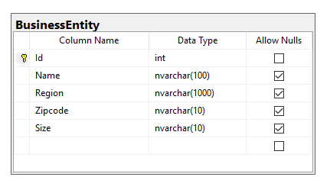
CREATE TABLE - BUSINESS ENTITY

Slide 35
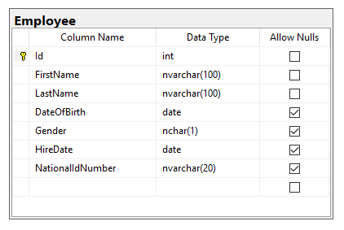
CREATE TABLE - EMPLOYEE

Slide 36
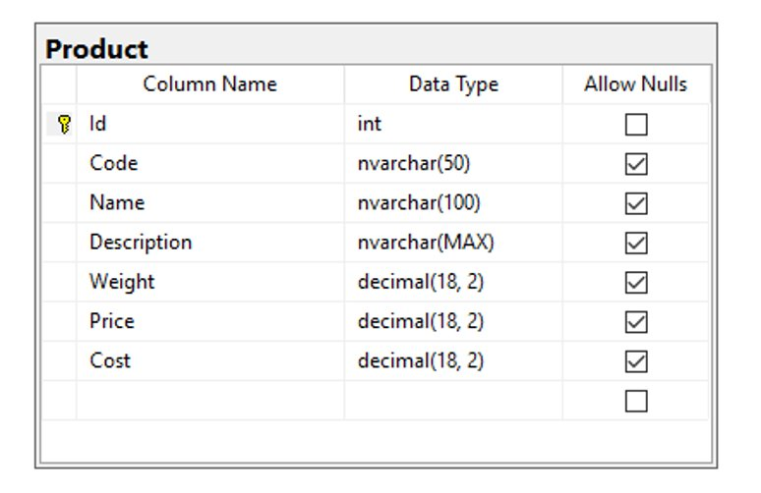
CREATE TABLE - PRODUCT

Slide 37
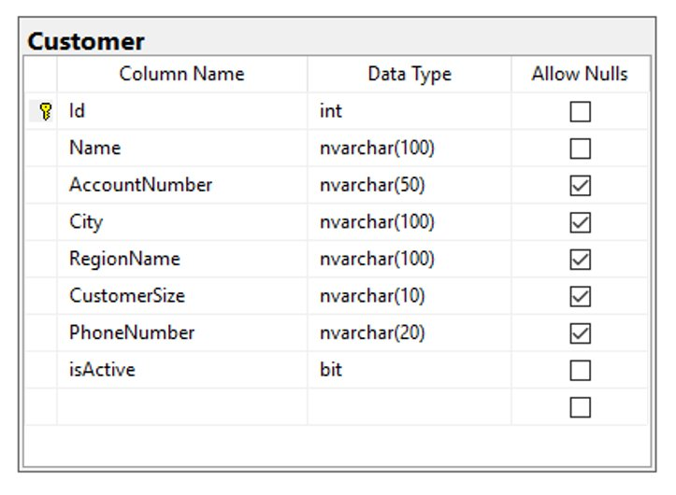
CREATE TABLE - CUSTOMER

Slide 38
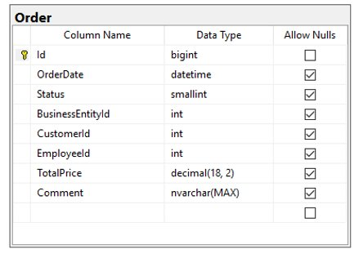
CREATE TABLE - ORDER

Slide 39
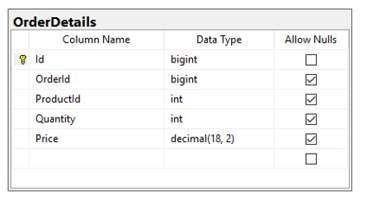
CREATE TABLE - ORDER DETAILS

Slide 40

HOMEWORK

Slide 41
HOMEWORK REQUIREMENTS
Create a database called SEDCACADEMYDB
CREATE 6 Tables:
Student
Teacher
Grade
Course
AchievementType
GradeDetails

Slide 42
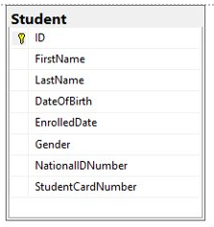
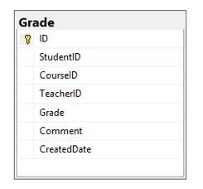
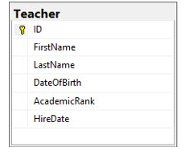
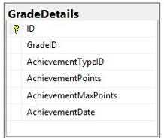
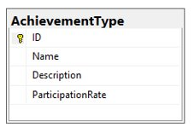
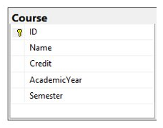

Slide 43
QUESTIONS?
You can find us at
daniloborozan07@gmail.com
ilija.mitev3@gmail.com
You can find the code at
https://github.com/sedc-codecademy/mkwd12-net-07-dbdevdesign/tree/main/g2

